Slide 1
T-PESS
Principal
Orientation
Training
Notes:
2 hour Orientation—Open with Welcome / Introductions (if needed)
5 min. 8:30 to 8:35
Note to Trainers:
This half-day T-PESS Orientation Training is intended to support districts that are preparing to implement T-PESS and desire to deepen their principals’ understanding of the system by which they will be evaluated. Even if principals attended the Two-Day T-PESS training previously, an orientation that provides additional local information on key elements of the T-PESS process may be beneficial and can serve to enhance the collegial dialogue that is at the core of the T-PESS process.
Districts may design or customize their own orientation for T-PESS. This module is as an example that meets the orientation requirement in the Education Code below.
§150.1025. Principal Orientation.
(a) A school district shall ensure that a principal is provided with an orientation of the Texas Principal Evaluation and Support System (T-PESS) either prior to or in conjunction with the pre-evaluation conference, as referenced in §150.1023(b)(2) of this title (relating to Appraisals, Data Sources, and Conferences) when:
(1) the principal is new to the district;
(2) the principal has never been appraised under the T-PESS; or
(3) district policy regarding principal appraisal has changed since the last time the principal was provided with an orientation to the T-PESS.
(b) The principal orientation shall include all state and local appraisal policies and the local appraisal calendar.

Slide 2
Review for Campus and District Leaders
Purpose: To clarify the expectations and process for T-PESS.
Principals/Appraisees will understand:
  The T-PESS evaluation system
  Expectations for Principals
  How performance will be measured on the rubric
  How to use the associated materials (forms, etc.)
  The T-PESS process: BOY, MOY & EOY
  Recognition this is an on-going process designed to promote professional growth
Notes:
Establish Purpose
2 min. 8:35 to 8:37
Read through slide:
The purpose of this orientation module is to ensure that Principals will understand:
The T-PESS evaluation system
Expectations for Principals/Appraisees
How performance will be measured on the rubric
How to use the associated materials (forms, etc.)
The T-PESS process is annual and on-going: BOY, MOY & EOY
The T-PESS process designed to promote professional growth

Slide 3
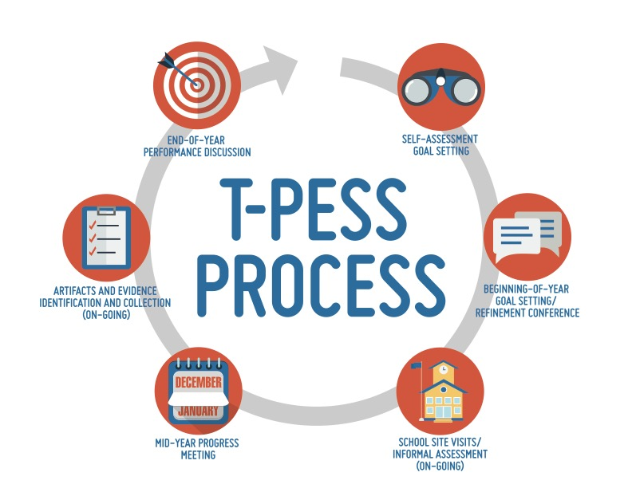
Evaluation System Process
Notes:
Overview of T-PESS Process
3 min. 8:37 to 3:40
Walk through the T-PESS graphic with the audience.
State: The T-PESS process includes various formative steps that results in an annual summary assessment of the principal. It is intended and best used as a growth-based model based on an annual process of actions and activities that self-assess, establish performance goals, collect and analyze information, and provide constructive feedback resulting in the improvement and refinement of practice.
T-PESS is intended to improve the quality and effectiveness of the principal through their personal involvement in the process, along with that of their supervisor or appraiser.

Slide 4
T-PESS
Steering Committee Priorities
Personify Continuous Growth and Improvement
Guide Self-reflection
Inform Professional Development
Improve Leadership Quality
Texas Principal Steering Committee, March 2014
Notes:
Steering Committee Priorities for T-PESS
3 min. 8:40 to 8:43
State: Just as a reminder, T-PESS was developed to align with these defining priorities established by the TEA Steering Committee. The priorities supported a theory of action that informed the development of the performance rubric and these purposes will be emphasized in the professional development that accompanies implementation.
Successful implementation of the system is dependent upon attending to the priorities, which should be treated as guiding principles for the evaluation system.
Emphasize this model is predicated on growth and development - NOT rank ordering leadership performance. The model is meant to guide professional development for principals.
Serve as a tool in developing coaching and mentoring programs for principals.
The implementation and evaluation of the system must embody continuous improvement.
Provide meaningful and credible feedback that improves performance.
The development and implementation of the evaluation systems must continue to involve stakeholders in a collaborative process.

Slide 5
Princl (Appraisee)
Expectations
Expectations for Principal (Appraisee)
Know and understand the Principal Leadership Responsibilities.
Understand T-PESS.
Prepare for and fully participate in each component of the evaluation process.
Gather data, artifacts, and/or evidence to demonstrate performance in relation to leadership responsibilities and progress in attaining goals.
Develop and implement strategies to improve personal performance/ attain goals in areas individually or collaboratively identified.
Notes:
Principal Expectations with T-PESS
2 min. 8:43 to 8:45
Go through the slide:
For T-PESS to fulfill the purpose of evaluation and realize the key priorities of the Texas Principal Evaluation Steering Committee, principals need to:
Know and understand the Principal Leadership Responsibilities.
Understand T-PESS.
Prepare for and fully participate in each component of the evaluation process.
Gather data, artifacts, and/or evidence to demonstrate performance in relation to leadership responsibilities and progress in attaining goals.
Develop and implement strategies to improve personal performance/ attain goals in areas individually or collaboratively identified.

Slide 6
Performance Standards
Texas Principal Evaluation
Pgs. 11-15
Standard 1
Instructional Leadership: The principal is responsible for ensuring every student receives high-quality instruction.
Standard 3
Executive Leadership:
The principal is responsible for modeling a consistent focus and personal responsibility for improving student outcomes.
Standard 4
School Culture:
The principal is responsible for establishing and implementing a shared vision and culture of high expectations.
Standard 5
Strategic Operations:
The principal outlines and tracks clear goals, targets, and strategies aligned to a school vision that improves teacher effectiveness and student outcomes.
Standard 2
Human Capital:
The principal is responsible for ensuring there are high quality teachers and staff in every classroom in the school.
Notes:
Principal Standards of the T-PESS Rubric
4 min.
8:45 to 8:49
Before you begin the transitions in this slide, ask the audience to be thinking about the significance of each Standard and the magnitude of what is being expected of principals.
Give them a minute to read the screen, then…
State: The “T-PESS Rubric is constructed from the five (5) Texas Principal Standards.. As you know from your previous training, these five (5) standards represent the goals Texas principals strive towards. The standards and the corresponding indicators, knowledge, and skills are designed to be aligned with the training, appraisal, and professional development of principals.
Ask for volunteers to read each Standard aloud.
Direct the group to listen for what each has in common.
State: What are your thoughts around these standards? What did you hear as the strands were read aloud.
Allow large group comments.
Then re-read Standard 5 aloud—Strategic Operations.
Ask if anyone has ever defined Strategic Operations in this way?
Explain: The Texas Principal Standards which comprise the T-PESS rubric are ALL ABOUT INSTRUCTION.
Note to Facilitator
The Texas Education Agency (TEA) and the Principal Advisory Committee completed new principal standards in 2013. These new standards (see Appendix A) are found in Chapter 149 of the Texas Administrative Code and are expected to serve as the foundation for the new leadership appraisal and support system. (Texas Administrative Code (TAC), Title 19, Part II Chapter §149.2001: Commissioner’s Rules Concerning Educator Standards: Principal Standards. Retrieved from (http://ritter.tea.state.tx.us/rules/tac/chapter149/)

Slide 7
T-PESS Rubric is Aligned to Texas Principal Standards
Standard 1 – Instructional Leadership: The principal is responsible for ensuring every student receives high-quality instruction.
  1a. Rigorous and aligned curriculum and assessment – The principal implements rigorous curricula and assessments aligned with state standards, including college and career readiness standards
  1b. Effective instructional practices – The principal develops high-quality instructional practices among teachers that improve student performance
  1c. Data-driven instruction and interventions – The principal monitors multiple forms of student data to inform instructional and intervention decisions and to close the achievement gap
  1d. Maximize learning for all students – The principal ensures that effective instruction maximizes growth of individual students and student groups, supports equity, and eliminates the achievement gap
Notes:
Alignment of Rubric to Texas Principal Standards
1 min.
8:49 to 8:50
State: For the first time we have an evaluation instrument that is completely aligned. The Texas Principal Standards are the foundation of the T-PESS rubric. The Indicators all align to the given standard. Never before have we had an instrument that is so well designed and aligned.
Ask: What value do you see in having this type of close alignment?

Slide 8
The T-PESS Rubric
Pg.16-18
Performance Standard
Indicator
Performance Level
Performance Descriptors
Notes:
Explanation of Performance Standards, Indicators, Performance Levels, and Performance Descriptors
2 min.
8:50 to 8:52
State: The T-PESS Principal Evaluation rubric has four major parts, beginning with the performance standard and definition. The performance standard is global in nature and intended to communicate a broad set of leadership performance expectations. Do you recall all the terms?
CLICK
State: Each standard is followed by four to five supporting indicators and their definitions. An indicator is a dimension or construct on which a performance standards is partly constructed. Each indicator implies one to three dimensions or constructs.
CLICK
State: Each indicator contains a number of leadership practices that are organized across a scale of performance levels beginning with “Distinguished” and progressing through “Not Demonstrated/Needs Improvement”. Rather than begin with a rating of “Unsatisfactory” or “Ineffective,” attempting to describe what leaders don’t know or are not able to do, the T-PESS rubric design exemplifies a growth model approach to performance improvement.
CLICK
State: Lastly, The T-PESS rubric contains the performance descriptors—the leadership responsibilities and evidence-based practices that communicate and differentiate leadership across the scale of performance levels. Each indicator implies one to three leadership dimensions or constructs that are vertically communicated across the scale. Taken together, these generate a robust set of practices that help guide leaders to higher levels.

Slide 9
Review the Rubric Conceptually
Notice, the skill(s)
and abilities increase in complexity and sophistication from right to left.
Notes:
This slide demonstrates how to review the rubric “conceptually” which is from right to left.
2 min.
8:52 to 8:54
State: T-PESS is grounded in research on effective leadership. The practices that are included in the rubric are taken from a number of empirically-based studies and publications most notably from the McREL publication: The Balanced Leadership Framework: Connecting vision with action (Waters & Cameron, 2007) and in the ASCD Publication: School Leadership that Works: From research to results (Marzano, Waters & McNulty, 2005).
The practices are described by performance indicators that differentiate between developing, proficient, accomplished and distinguished performance levels. As you read from the right to the left, you will notice how the skills and abilities increase in complexity and sophistication.
When completing the self-assessment, campus leaders are encouraged to read from right to left across the rubric to make sense of it as a whole.
Note: This is different from how the instrument is scored.

Slide 10
Performance Levels
Distinguished | Principal consistently and significantly exceeded proficiency on standard(s) of performance. Direct comment is required.
Accomplished | Principal exceeded proficiency on standard(s) of performance most of the time.
Proficient | Principal demonstrated competent performance on the standard.
Developing | Principal demonstrated adequate growth toward achieving standard(s) during the period of performance, but did not demonstrate proficiency on standard(s) of performance.
Not Demonstrated Needs Improvement | Principal did not demonstrate the competence on achieving standard(s) of performance. Direct comment is required.
Notes:
T-PESS Performance Levels
1 min.
8:54 to 8:55
State:
T-PESS performance levels exemplify a growth model evaluation system. The ordinal rankings have specific definitions.
CLICK
We begin with:
Developing— Principal demonstrated adequate growth toward achieving standard(s) of performance during the period of performance, but did not demonstrate competency.
CLICK
Proficient—Principal demonstrated basic competence on standard(s) of performance.
CLICK
Accomplished—Principal exceeded basic competence on standard(s) of performance.
CLICK
Distinguished—Principal consistently and significantly exceeded basic competence on standard(s) of performance.
CLICK
Not Demonstrated/Needs Improvement—Principal did not demonstrate the competence on or failed to demonstrate adequate growth toward achieving standard(s) of performance. If “Not Demonstrated” is used the appraiser is required to provide direct comments.
CLICK
These tiered performance levels encourage novice school leaders as they learn and develop their leadership abilities. At the same time, this encourages and inspires experienced leaders to continue to develop and hone their instructional leadership skills. However, it is important to realize that over time, evaluation results will be used in making important resource allocation decisions, such as professional development and continuing status decisions.

Slide 11
T-PESS Rubric (Rating System)
Pgs. 33-35
…and
…and
…and
Notes:
T-PESS Rating System
2 min.
8:55 to 8:57
State: The T-PESS rubric is used for evaluation by using a cumulative and additive method. Final ratings for each element are determined by the data collected from all site visits conducted during the annual evaluation cycle, by artifacts collected and submitted, and by other evidence that may be required by a school district as part of the evaluation of principals. Appraisers will determine the final ratings based on the scoring rule similar to scoring the rubric.
Additive-Cumulative Scoring as designed by McREL:
Review of the Rating Rule:
􀁸 To receive a specific rating for an indicator, the principal must have received at least one check
during the course of the evaluation cycle on ALL the descriptors in that category and ALL the
descriptors in the previous category, taking into account all observations of the principal.
􀁸 If the principal has not met the minimum requirements (check marks for all the descriptors in
the Developing category at some point during the evaluation cycle), then his or her rating would
be considered Not Demonstrated, which requires a narrative from the appraiser stating the
reason for the rating.
Ask: What questions do you have about the rating system? Did you encounter any challenges with it during the initial implementation year?

Slide 12
Revisiting the Rubric
Pgs.
51--72
Notes:
Revisit the Rubric
1 min.
8:57 to 8:58
The rubric is directly aligned with the principal standards and is an essential component of the T-PESS process – so let’s revisit the rubric to deepen our understanding. ( Have participants get their T-PESS rubrics ready to review.)

Slide 13
T-PESS Rubric Jigsaw
Home Group
Form groups of 5 people for Jigsaw Home Group.
Each person will be responsible for one becoming an expert in one of the five Principal Standards and all its related indicators within the T-PESS Rubric.
Prepare to move into Expert Groups
Notes:
Jigsaw Activity (An accelerated means to review the T-PESS Rubric)
2 min.
8:58 to 9:00
Use the jigsaw technique to deconstruct the rubric. It is best to have participants work in groups of 3 - 5 for this activity, if possible, since there are 5 Standards.
If the group is very large, you can leave participants in the original groups of 3 - 5 and have them summarize each Standard with its Indicators instead of creating expert groups. This is a Presenter decision.

Slide 14
Move into EXPERT Groups
Standards 1, 2, 3, 4, & 5
FOCUS on the PROFICIENT COLUMN and discuss the following:
What is the most important take-away or key point from each indicator?
What do the indicators look like for principals within the context of their daily work?
What type of evidence and artifacts will supervisors look for?
Notes:
Jigsaw Preparation—move participants into EXPERT GROUPS around the room for Standard 1, 2, 3, 4, & 5 according to the numbers they were assigned.
6 min. 1 minute for movement into Expert Groups-- 5 min for silent reading.
9:00 to 9:06
Review slide to prepare for deconstruction Jigsaw.
Allow 5 minutes for individual reading. This is a quick skim because participants are reviewing ALL the indicators in a given Standard. Ask them to FOCUS on Proficient. They can glance left and right, but their concentrated attention to answer the questions is on PROFICIENT.
Example—If you are assigned Standard 1, you skim through 1a, 1b, 1c, & 1d focusing on PROFICIENT—glancing to the left and right. The reader attempts to take capture an overall understanding of the Standard through the proficient lens.
Questions to think about as they are reading silently:
What is the most important take-away from each indicator?
What do the indicators look like for principals within the context of their daily work?
What type of evidence and artifacts will supervisors look for?
As participants deconstruct the rubric, they should ask themselves these questions:
What is this Indicator about?
What does it look like for principals in their daily work?
What does it require of principals?
The purpose of deconstructing the rubric is to create personal meaning and understanding of the instrument.

Slide 15
Return to Jigsaw Home Group
Each person returns to their Jigsaw Home Group to share the most important performance expectations that are communicated by the Standard and its indicators—focusing on the proficient column.
Notes:
Final Round of Jigsaw
11 min. - 1 min. to return to original Home Jigsaw groups then 10 minutes to share out and cover the entire rubric in summary from. (2 minutes per Standard. )
9:06 to 9:17
Allow 2 minutes for each person to share highlights of the most important aspects.
10 min. total--be sure to pace the groups. They will have to summarize quickly.
Process questions for large group upon conclusion of group work.

Slide 16
T-PESS Look Fors
Pg.
47-48
Take a look at pages 47-48 in your Orientation Manual.
These “Look Fors” represent the main performance elements of the T-PESS Rubric.
To what extent did your expert summary discussions address these elements?
Notes:
T-PESS Look Fors
2 min.
9:17 to 9:19
State: Take a look at page _____ in your Orientation Manual. These “Look Fors” represent the main elements of the T-PESS Rubric.
Ask: To what extent did your expert summary discussions address these elements?

Slide 17

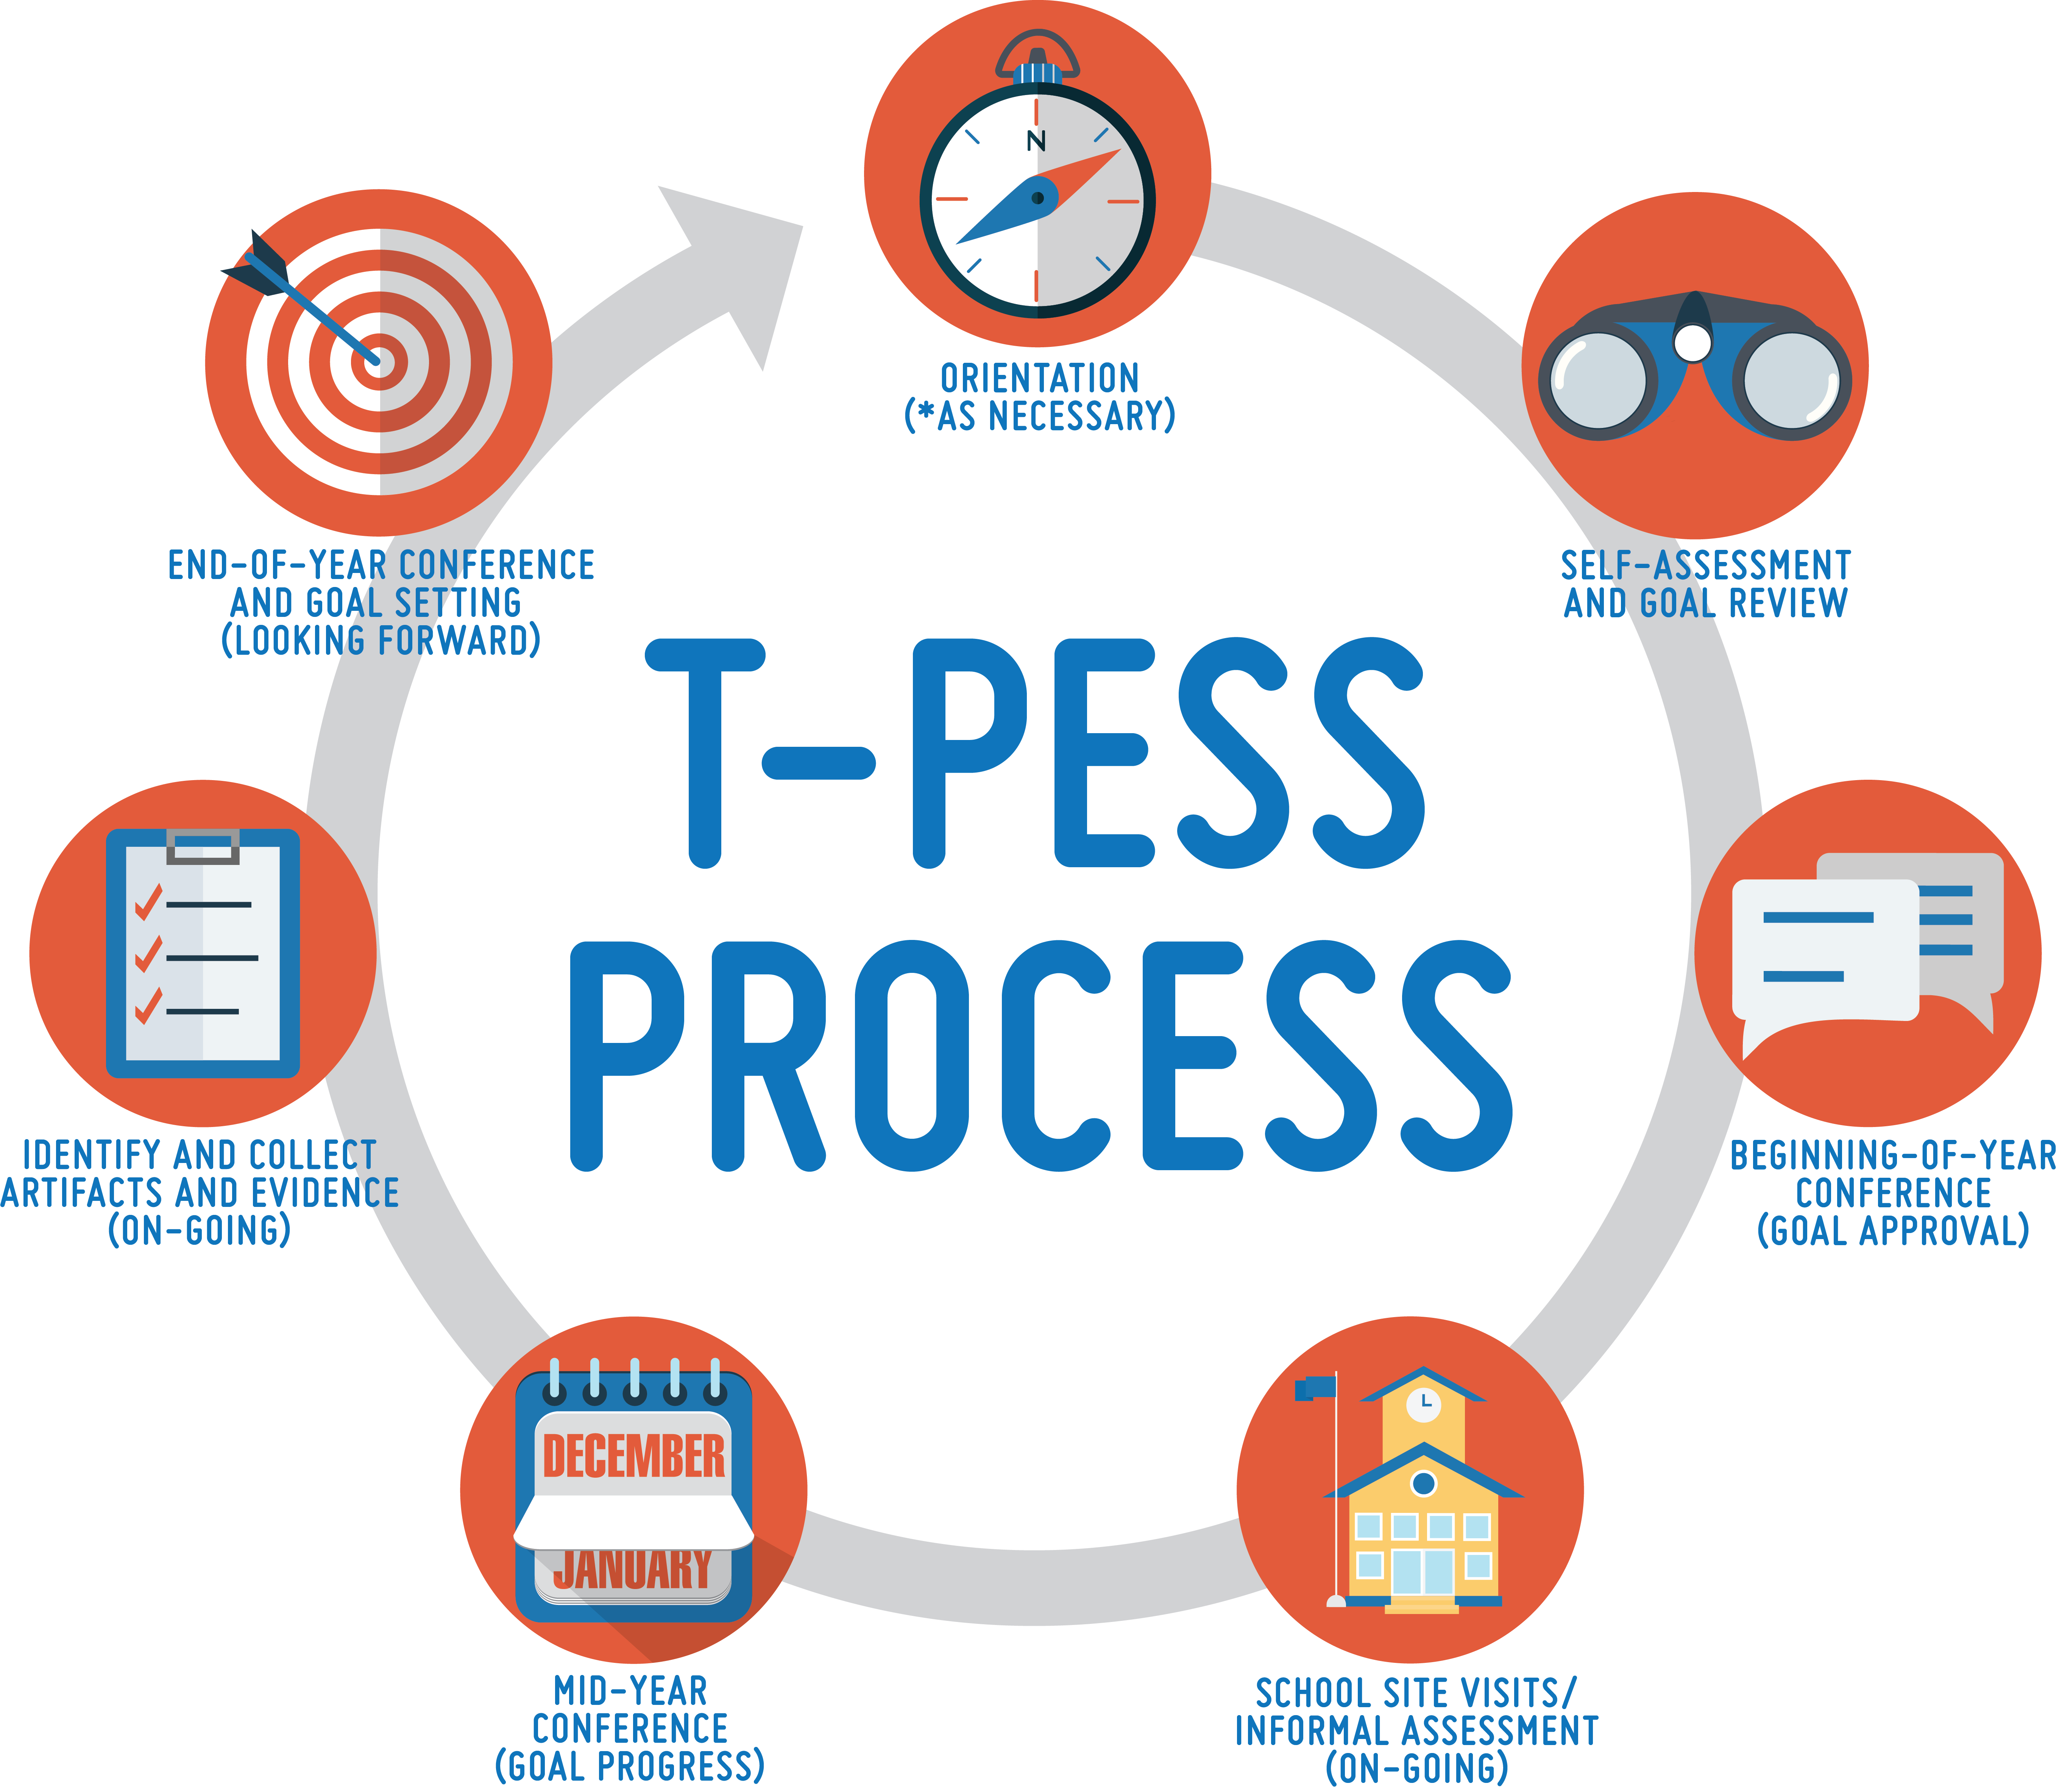
Step 1: Orientation
PM
Pg. 24
Take one minute to review the Participant Manual for information on the first step in the T-PESS process: Orientation
This session is your ORIENTATION to T-PESS.
Notes:
Review of Participant Manual to provide Background Knowledge on Orientation and Self-Assessment.
1 minute—instruction and silent reading of User Guide.
9:19 to 9:20
State: We are currently conducting the orientation so we are in the initial step. You can reference page 24 in your Participant Manual.

Slide 18

Step 2: Self-Assessment and Goal Setting
Pg. 24
Take a few minutes to review the Participant Manual for information on the second step in the T-PESS process: Self-Assessment and Goal Setting.
Make note of any new information or questions.
Notes:
Review of Participant Manual to provide Background Knowledge on Self-Assessment and Goal Setting.
2 minutes—silent reading of User Guide.
9:20 to 9:22
State: Take a few minutes to read and highlight the updated T-PESS Participant Manual regarding Self-Assessment and Goal Setting.

Slide 19
Self-Assessment and
Goal Setting
Pgs.
25 & 26
Purpose: To reflect on past performance, feedback from supervisors and colleagues, and benchmark performance against the criteria in the evaluation rubric.
Each principal (appraisee) will complete a self-assessment at the beginning of every year.
The self-assessment provides the basis for goal setting and planning for professional development.
Notes:
Self-Assessment is one of the most important elements of the process for principals. This is where they think deeply about their own capacity and what they want to improve professionally.
2 min.
9:22 to 9:24
State: While there are many reasons for conducting a self-assessment, the primary purpose here is to provide a solid foundation on which for collegial conversations about leadership, clarify expectations associated with performance improvement, and serve as the basis of goal setting and professional growth plans.
Principals deepen their understanding of the T-PESS rubric when they devote time to reading each standard and its related indicators to better under the level of performance that is expected.
Previous evaluation instruments may not have been as rigorous nor as comprehensive as the T-PESS rubric. Just like T-TESS, where more is being asked of teachers with regard to professional performance, T-PESS holds a very high standard for Principal performance.
T-PESS, like T-TESS uses an aspiration rubric—there is room for every principal, no matter how experienced, to grow with this instrument.
Ask: How comfortable were principals with the self-assessment they led with teachers? They will engage in the same reflective practice.

Slide 20
Identifying Areas for Professional Growth
Pgs.
28 & 29
Goal/Growth Opportunity
Notes:
T-PESS Self Assessment
2 min.
9:24 to 9:26
State: The review of the self-assessment form by the appraisee as well as the appraiser involves reading each descriptor to determine the evidence that best describes the current level of performance.
This review method, going descriptor by descriptor, identifies the next step to goal setting and professional growth. Principals are encouraged to self-select an area for growth from within the T-PESS Rubric by using this process. It is important for the principal to select an area of growth that he or she desires. The personal goal should NOT be a campus plan goal.
Professional growth goals pertain to the skills and abilities of the individual.

Slide 21
Goal Setting Form
State your goal here.
What rubric standards or indicators are related to your accomplishing the stated goal? List those here.
List the key steps you need to do to accomplish the goal.
How will you measure your goal attainment? List the outcomes relevant to goal attainment.
What is the timeline for when the goal should be completed? Are there deadlines for particular steps?
List any materials, resources, or special support you are dependent upon to complete your goal.
Additional comments, special conditions, or expectations pertaining to the goal
It is important that both the appraiser and the principal discuss and agree to the nature and expectation of the goal.
Notes:
The T-PESS Goal Setting Form leads the principal through the goal setting process. Districts may design a local form if preferred.
2 min.
9:26 to 9:28
(Click to highlight each section of the document. Take your time with this explanation.)
State: “This is the Beginning-of-year: Goal Setting Form. This form is intended to be used to set a single performance goal. Because of the dynamic and complex nature of school-level leadership, we strongly recommend that principals and their appraisers limit goal setting to the two required goals—one pertaining to principal practice and the other pertaining to student growth. Including too many goals limits the principal’s ability to focus and effectively execute his or her plan. In the end, districts may develop their own forms for goal setting. This is the example provided with T-PESS. It is the process that is paramount. The self-selection of a performance goal activates internal locus of control and personal motivation. Supervisors are collaborators in the process because they give feedback and help to refine the goal(s) set by the principal.
Each goal should focus on the connection between the goal and the T-PESS standards and indicators best believed to support goal attainment. Principals should carefully consider the actions and activities and the alignment of resources (Kaplan & Norton, 2008) that will most effectively accomplish the goal and improve their performance.
NOTE: This slide has multiple transitions that highlight briefly explain each section of the T-PESS Goal Setting Form. Review the slide with participants making the connection between the sections of the form and the SMART criteria to be used for completing the form.

Slide 22
For 2017-2018—Two Goals
Professional Practice Goal
A professional practice goal is selected by the principal after reviewing the Standards of the T-PESS Rubric.
Student Growth Goal
A student growth goal should consider root causes of student performance and identify an area to improve over time.
Notes:
New: Two goals for the principal in 2017-2018 --one “Professional Practice” and one “Student Growth”
1 min.
9:28 to 9:29
State: We want to be sure principals understand they have an opportunity to write a goal that is specifically about their professional practice. It should be personal and meaningful to them while tied to the Standards of the Rubric.
The second goal, required by Commissioner’s Rule as of 2017-2018 is a Student Growth Goal.
For 2017-18 they will be crafting TWO goals—their Practice Goal and their Student Growth Goal.

Slide 23
Sample Goal To “Coach Up”
Notes:
This is a sample annual goal that could use some “coaching-up”
2 min.
9:29 to 9:31
State: So let’s take a look at this goal… (read goal)
ASK: Do you consider this goal to be more related to an individual principal’s professional growth or is It more related to a District initiative?
Answer: Most people see this as more related to a district initiative. It is a worthy goal. We just want to be sure every principal in Texas has at least one goal that is tied to the development of his or her personal leadership skill and ability.
State: This goal could be slightly tweaked to focus in on the skill the principal has identified which is the capacity to EVALUATE implementation of a curriculum. The criteria that is identified includes students having access to the curriculum and teachers having time to teach the curriculum.

Slide 24
Sample Annual Goal—Revised
Principal “Practice” Goal
I will strengthen my capacity to support and evaluate the effectiveness of implementation of new curriculum to ensure all students have access and teachers have time to teach the curriculum.
Notes:
Slightly Revised Annual Goal
2 min.
9:31 to 9:33
State: Principals draft their personal goals and then meet with their supervisor to discuss. This is a collaborative process and the supervisor should be comfortable to provide feedback. In this case, with just a slight adjustment, the Annual Goal becomes more personalized and specific to the skill to be developed.
ASK: Do you believe the Leadership Standards and Indicators that have been selected are on target?
ASK: How about the strategies and actions the principal has identified? Do you see these as supporting the growth that is desired?
ASK: How about the time line for achieving the goal—does it appear realistic?
ASK: Are the resources within reason?
State: This is the process a supervisor will go through to provide feedback to the principal.
Allow for natural discussion that may arise.

Slide 25
Professional Practice Goal
As you reviewed the T-PESS Rubric in the Jigsaw Activity, was there a Standard that stood out for you…one where you might select a growth goal?
For practice, select an indicator from the T-PESS Rubric and draft a goal for “Professional Practice.”
Work individually to write a draft goal.
Notes:
Draft a Practice Goal—This can be combined with the upcoming break to afford more time.
2 min. 9:33 to 9:35
State: Now we are going to draft a professional practice goal from the rubric. Select something that is meaningful.
Ask: Was there a Standard that stood out for you…one where you might select a growth goal?
Direct participants to write a professional practice goal.

Slide 26
Student Growth Goal
Pgs. 41-46
Student Growth is addressed in the form of a goal—just like Principal “Practice”.
This goal should be related to the improvement of student performance over time.
A growth goal may address that student progress can take more than one year.
Notes:
Student Growth: Consider Root Causes
4 min.
9:35 to 9:39
State: Beginning with the 2017-2018 school year, student growth will become a component in principal appraisal within the commissioner’s recommended principal appraisal system, the Texas Principal Evaluation and Support System or T-PESS.
The inclusion of a student growth measure allows principals to focus on a particular area of concern as it relates to student performance, capture strategies and actions that should lead to improvement in that area, and assess the impact the principal’s practices and leadership had on the student performance outcome.
For student growth to be a valuable tool in continuous improvement, principal supervisors should keep the following in mind:
Although it’s called student growth, it is really about principal growth;
Student growth is not the end in itself – the key to a meaningful student growth goal is the ability to translate the student growth outcomes into feedback on leadership practices;
Honest assessment of practice, sincere reflection on the approach to planning and implementation, and a commitment to adjusting leadership practices when targets aren’t met are the best ways to improve student growth;
Ratings are less important than the process of professional growth.
Go over this the slide, point by point. There is some new learning here as we introduce the idea that a growth goal can be set for a period of time longer than one year and that non-academic that influence student performance can also be considered such as attendance, discipline, etc.
Allow for audience reaction and brief discussion.

Slide 27
Growth Goal Considerations
Scenario: As principal, one area you’re considering as a focus for your student growth goal pertains to AP performance on your campus.
Background Information:
AP scores have been relatively flat for the past three years.
AP test participation rates have not risen as hoped.
AP testers do not represent overall population; lack of minority student participation.
AP student survey data indicates some students opt out of taking the exam even though they have taken the course.
Notes:
Growth Goal Considerations
2 min.
9:39 to 9:41
State: Let’s practice with this idea by considering a realistic scenario regarding AP performance.
Ask someone in the audience to read the scenario aloud.
Ask someone in the audience to read the background information aloud.
Tell them they are going to use this information to conduct a brief root cause analysis.

Slide 28
Root Cause Analysis
As a table, brainstorm possible root causes why AP performance has not been improving.
AP scores have been relatively flat for the past three years.
AP test participation rates have not risen as hoped.
AP testers do not represent overall population; lack of minority student participation.
AP student survey data indicates some students opt out of taking the exam even though they have taken the course.
What steps would you take and what data would you want to review to help you better understand why this might be happening?
Notes:
Root Cause Analysis Table Discussion
6 min. 3 minutes to brainstorm, 3 minutes to share out with large group.
9:41 to 9:47
State: Using the information that was provided in the scenario, talk at your tables about some possible root causes that are going on.
Ask aloud: What ideas do you have about why scores have remained flat?
Why do you think participation is not growing?
Why might minority students be under-represented in these classes?
You have three minutes to discuss.
After three minutes—have the group share one idea per table—rule of no repeat. Capture ideas on chart paper.
State: So these are some of our ideas about why this is happening. Of course, we will do more research to inform ourselves.
For our growth goal, we will want to address the multiple areas we believe are limiting progress. That is why it is best to consider this goal over time. It is complex and requires purposeful planning and work on many different fronts.

Slide 29
Sample Long Term Growth Goal
Local Form
Goal: To increase AP participation and improve the number of passing scores on AP exams by 15% over the course of the next three years.
Summer Metrics 2017: Attend data-driven training for principals; conduct training for all teachers during summer PD, configure master schedule for common off period to support PLC meetings to discuss data.
Fall & Spring Metrics 2017-2018 (Year 1): Use SLO process in conferences; conduct mini observations with coaching sessions for teacher; attend PLCs to examine rigor through analysis of student tasks; provide recognition for AP success; visits classrooms to promote AP participation; ensure all new to AP attend Summer Institute.
Mid-Term Metrics (Year 2): Increase enrollment in Pre-AP and AP courses by 10% for 2018-19; increase 2018 passing scores by 10%, increase percentage of teachers rating proficient or above on SLO by 20%.
Long-Term Metrics (Year 3): Increase enrollment in Pre-AP and AP courses by 15% for 2019-2020 and 2020-2021; increase AP passing scores by 15% for 2019 and 20% for 2020.
Notes:
Sample Long Term Growth Goal
4 min.
9:47 to 9:51
State: So here is an example of what one school might determine. Another campus could come up with a slightly different approach. Growth goals are specific to the campus and its content.
As we stated before, student growth in T-PESS takes the form of a goal. Principals and their appraisers will use the Goal-Setting Form (or a similar form if the district has created its own Goal-Setting Form) to create a goal related to the improvement of student performance over time. This is an example of a LOCAL FORM.
Just like with the practice goal, the student growth goal should detail the strategies and actions the principal will lead to attain the improvement in student performance.
Also like the practice goal, progress on the student growth goal should be discussed during the middle-of-year conference and end-of-year conference, and principal appraisers should use it as a tool that focuses their coaching conversations with principals.
State: This example shows a local approach/form that places an emphasis on the metrics that will be used to determine progress and attainment of the student growth goal over the course of three years. That is acceptable and even necessary for a student growth goal of this magnitude.
For the purposes of the AP scenario we have described, the principal has decided to craft a goal for improving performance substantially over the next three year. The principal has used the approach of writing metrics or performance targets over the next three years. This goal will be revisited multiple times and the plan of action can be revised as needed.
Note: More support for deepening understanding of student growth goals will be made available on the T-PESS.org website and through T-PESS Tips that are sent out to all districts using T-PESS.

Slide 30
Think About a Possible Long Term Student Growth Goal
To communicate urgency and prompt the kind of change our students need, long term growth goals must be both ambitious and attainable.
This means the principal may identify an area that he or she knows needs to improve faster than the school has been improving in recent years.
The timeline for reaching student growth goals matters.
A shorter timeline can make a goal more ambitious, conversely, giving a principal more time to reach a growth goal makes that goal more attainable.
Note: We must balance ambition of the student growth goal with attainability.
Notes:
Think About a Long Term Student Growth Goal
2 min.
9:51 to 9:53
We want to allow participants an opportunity to consider possible long term growth goals. At this point, we expect people will be grappling a bit—so the discussion at the table will help people make sense and personal meaning out of the concept.
State: To communicate urgency and prompt the kind of change our students need, long term growth goals must be both ambitious and attainable.
This means the principal may identify an area that he or she knows needs to improve faster than the school has been improving in recent years.
The timeline for reaching student growth goals matters. A shorter timeline can make a goal more ambitious, conversely, giving a principal more time to reach a growth goal makes that goal more attainable.
Note: It is important to balance ambition and attainability.

Slide 31
Ask Yourself…
If my school were to continue to make gains similar to those we’ve made in recent years, will we be making good progress?
If not, are there other factors that are impeding our progress such as attendance, or lack of curriculum or discipline concerns?
Any of these could be the focus of a long-term growth goal along with academic issues such as improving the number of students taking advanced math or CTE courses.
Notes:
Long Term Goal Practice
2 min.
9:53 to 9:55
Walk the participants through this series of questions. Ask them to think about their own campus or a campus they supervise.
Ask: If my school were to continue to make gains similar to those we’ve made in recent years, will we be making good progress?
CLICK
Ask: If not, are there other factors that are impeding our progress such as attendance, or lack of curriculum or discipline concerns?
CLICK
Ask: Any of these could be the focus of a long-term growth goal along with academic issues such as improving the number of students taking advanced math or CTE courses.

Slide 32
Partner Discussion
Turn and talk with a neighbor about a possible student growth area for long-term focus.
The duration of the goal will depend on what is to be accomplished.
The goal will include short term, mid-way, and long term metrics—or measurement over time.
What ideas come to mind about possible student growth goals? Just come up with one or two possibilities to share.
Notes:
Partner Discussion Re: Long Term Student Growth Ideas
3 min.
9:55 to 9:58
We want to allow the audience time to really think about long term goals. They do not have to be certain of their goal at this time, but should have some practice with considering ideas and applying the idea of accomplishing a goal over time—short term, mid-way, and final assessment.
State: Turn and talk with a neighbor about a possible student growth area for long-term focus.
The duration of the goal will depend on what is to be accomplished.
The goal will include short term, mid-way, and long term metrics—or measurement over time.
Ask: What ideas come to mind about possible student growth goals? Just come up with one or two possibilities to share.

Slide 33
Assessing Goal Progress and Goal Attainment
Notes:
State: Part of the Goal-Setting process involves determine which sources of evidence will best help determine goal attainment. There are multiple forms of evidence that can be collected throughout the year. It is very important to identify and discuss the artifacts / evidence that will be essential to determining goal attainment in the beginning of year conference.
1 min.
9:58 to 9:59
Notes - Review this slide with participants carefully. We know from pilot year districts that there are many questions around artifacts and evidence.
Cover each type of evidence: Direct Observation, Indirect Observation, Artifacts and School Data—read through the description on the PPT.

Slide 34
Possible Artifacts for Administrators
Professional Practice Related to Standards | Multiple Measures of Student Learning & Growth | Professional Responsibilities Related to Standards
Staff meeting plans/agendas Log of observations Notes/feedback from observation meeting Notes and feedback from observation/post observation conference Surveys about instructional leadership Staff Communication Teacher Professional Development | Campus Ratings (School growth, Indices) Graduation Rate* Discipline Data* National, international, district or school-wide developed assessments | Staff survey results Parent/Principal communications PTA meeting notes Self-reflection School/District Improvement Plan Professional Goal Setting Master Schedule Staff Retention Rate Documentation of Distributive Leadership (shared leadership)
Notes:
Here are some more possible artifacts for administrators
2 min.
9:59 to 10:01
State: Artifacts should be naturally occurring. Principals are NOT creating portfolios. Each site visit (Step 4 and ongoing) conducted by a supervisor is an opportunity to review artifacts and make observations for goal attainment and the T-PESS Standards.
Invite participants to review this slide on their own.
Ask: What might you add to this list of possible artifacts? Process with the large group.

Slide 35
Goal Setting and Professional Development Plan (GSPD)
The T-PESS GSPD plan is reviewed and revisited over the course of the year:
Beginning-of-the Year Goal Setting (Practice Goal & Student Growth Goal)
Mid-Year Progress Review toward Goal Attainment
End-of-Year Goal Attainment
Other times as helpful for professional reflection and feedback
Notes:
The GSPD process (Goal Setting and Professional Development) Make reference to the cyclical T-PESS Process Chart.
2 min.
10:01 to 10:03
State: “The T-PESS GSPD plan consists of three main parts (see #1 – 3) but may be reviewed and revisited as helpful throughout the year.
Beginning of the Year Goal Setting
Mid-Year progress toward Goal Attainment
End-of-Year Goal Attainment”
Other times as helpful for professional reflection and feedback
ASK for any questions or comments.

Slide 36
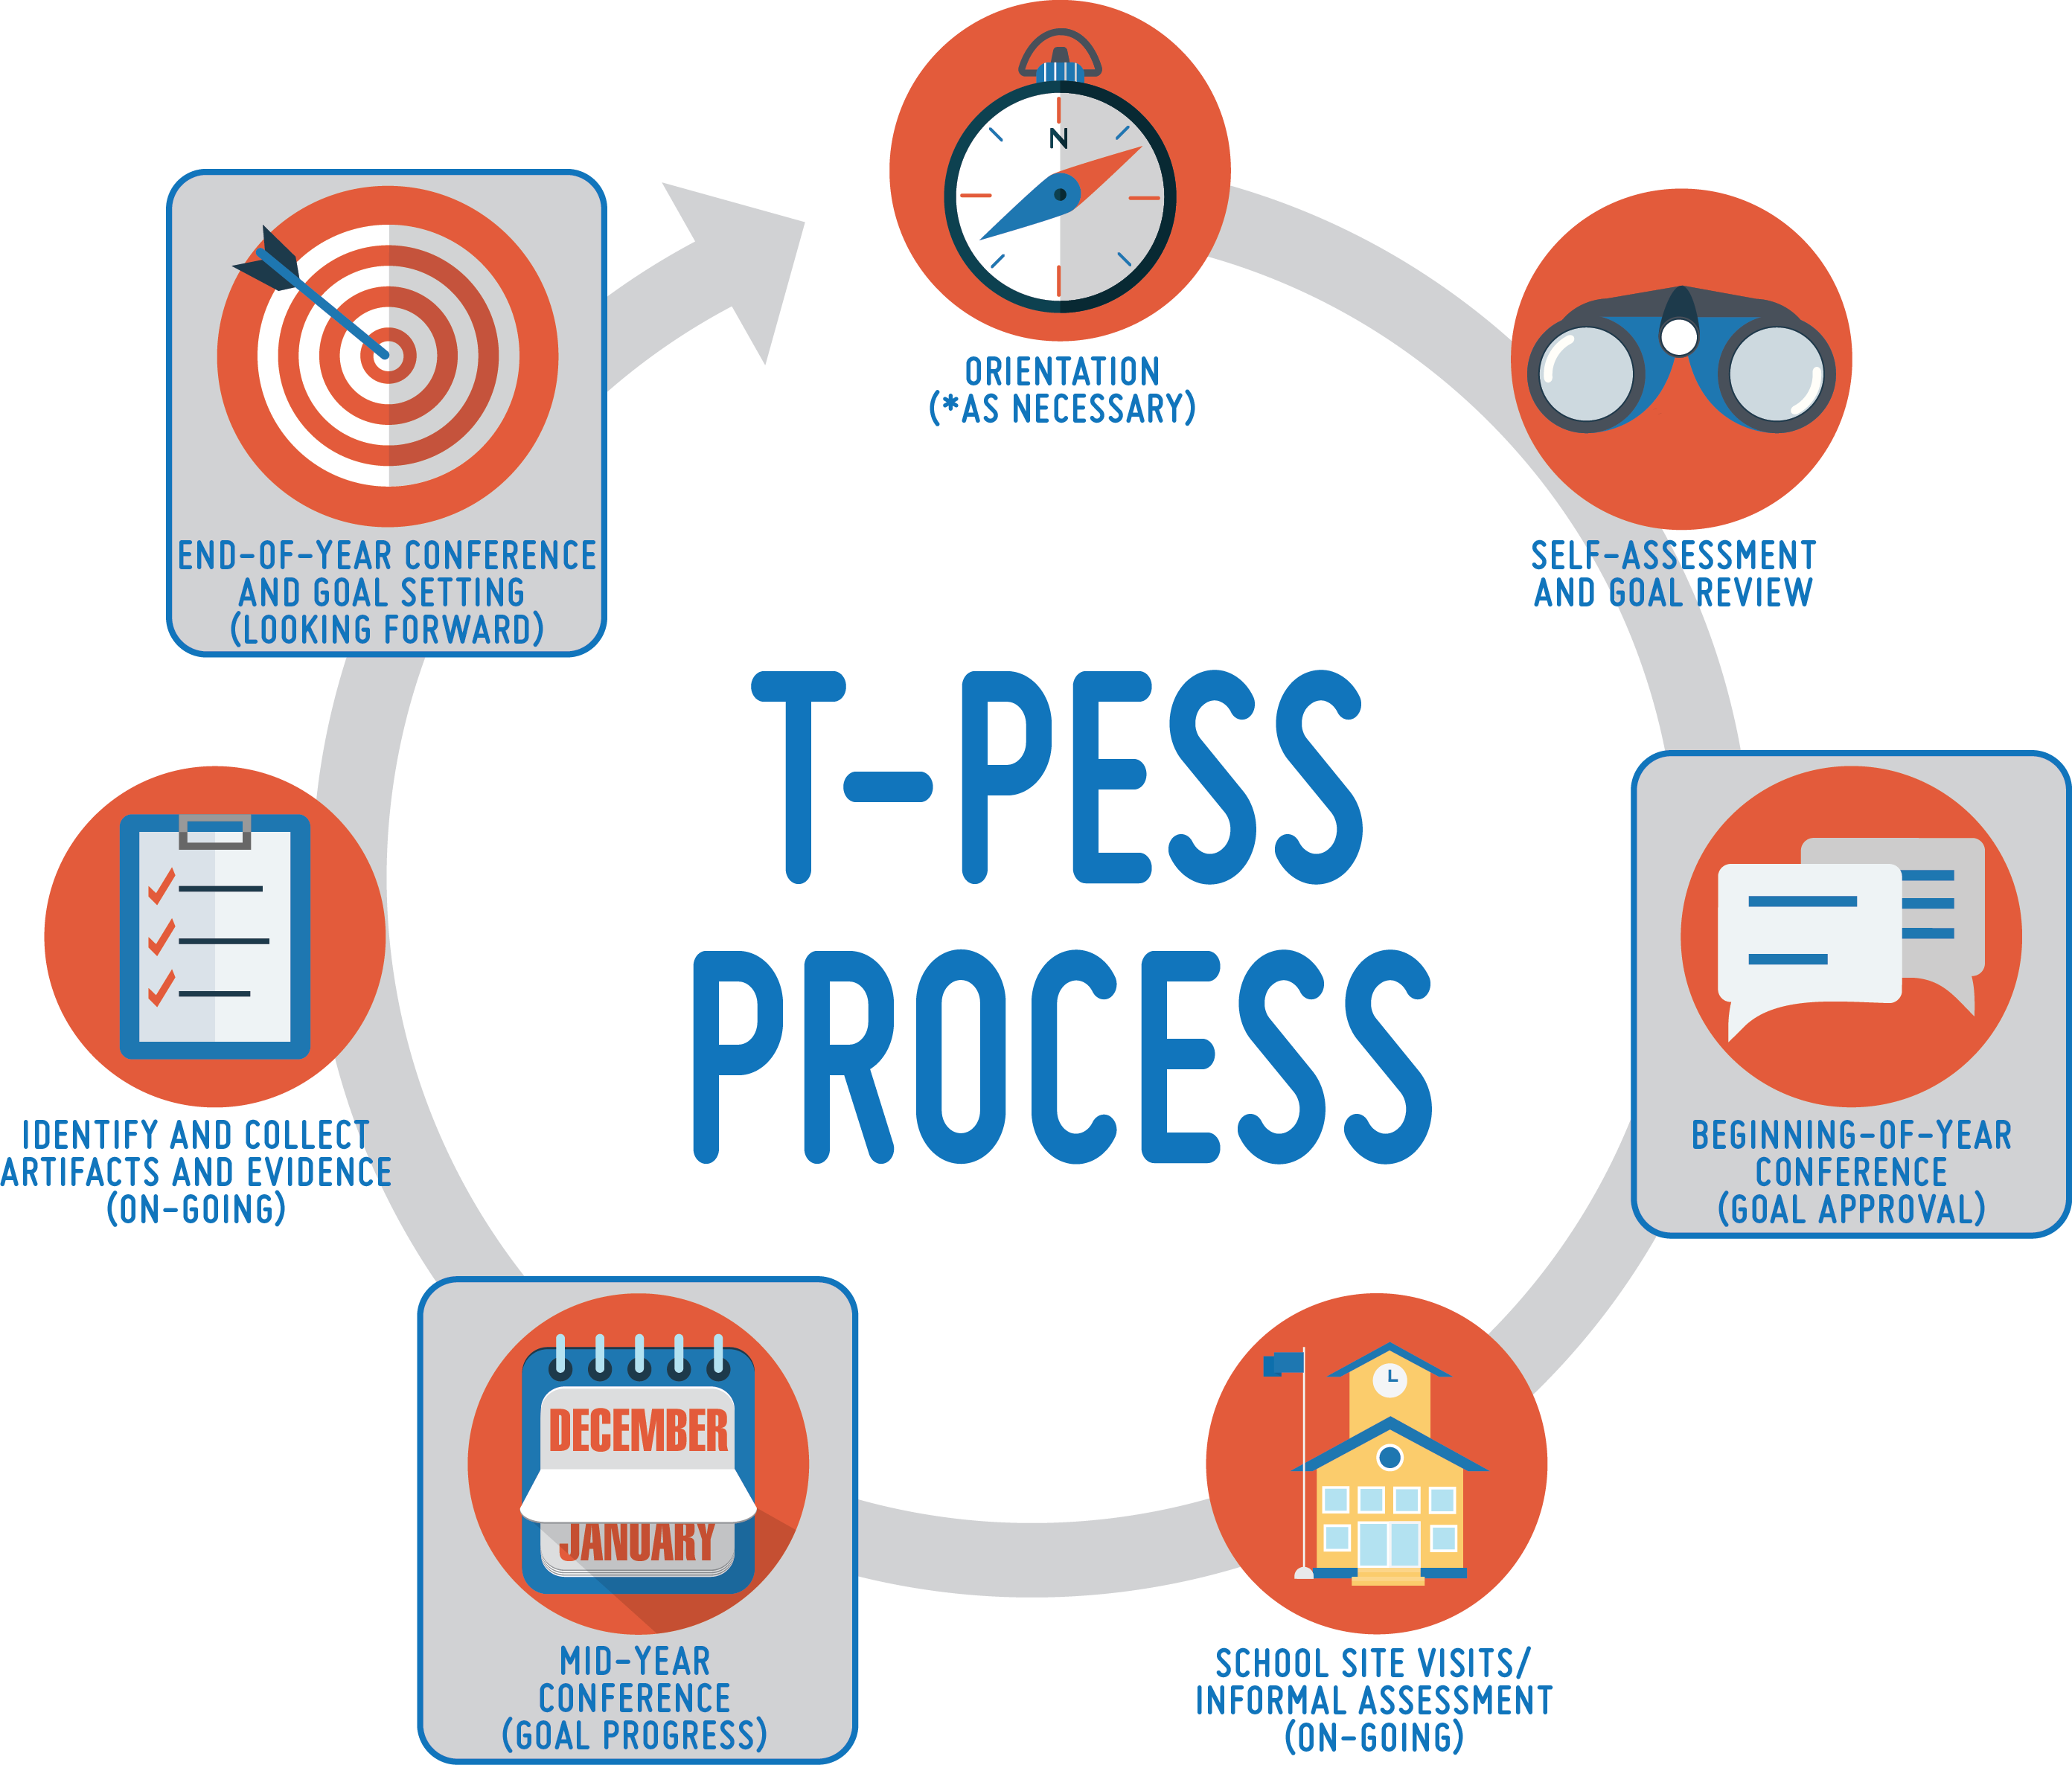
Step 3: Beginning-of-Year
Conference
Pg. 30
Take a few minutes to review the Participant Manual for information on Step 3: Beginning of Year Conference.
Make note of new information and questions.
BOY Conference Video available on TPESS.org
Notes:
Review of Participant Manual to provide Background Knowledge for Beginning of Year Conference.
10:03 to 10:06
3 min. for silent reading
State: Take a few minutes to read and make notes about the next step in the T-PESS process: Beginning of Year Conference.
Facilitator ensures a quiet environment for silent reading for 2 minutes. This activity is helpful to some of the adult learners in the room. The T-PESS graphic is helpful to others. We are trying to support everyone in gaining a strong conceptual understanding of the T-PESS process.

Slide 37
Beginning of Year Goal Setting Conference
Self-assessment by principal using T-PESS rubric and student performance data.
What did the review of the rubric and self-assessment reveal about professional practice?
What does school data indicate about student student growth and how can the principal leverage improvement over time?
2 Goals
Set by principal for professional practice and student growth in collaboration with supervisor
Specify the professional practice goal in relation to the T-PESS Rubric and the growth goal in relation to student performance.
Determine success indicators for both goals.
Consider possible sources of evidence and artifacts.
Actions/Develop GSPD Plan
Monitor Progress
Identify the strategies and actions that will be put in place and acted upon to accomplish the stated goals.
GSPD plans are comprehensive and should be revisited throughout the year.
Monitor GSPD Plans and progress toward goal attainment.
Establish processes for self-monitoring and assessment.
Notes:
The BOY Conference is an important conversation during which the appraiser and principal make decisions about the goals for the year.
2 min.
10:06 to 10:08
Share the graphic of the BOY Conference with the group. We know that for some people, this visual model will help solidify the process.
Remind the audience that principals will have two goals that will be addressed in their GSPD plan.

Slide 38

Step 4: Site Visits
Informal Assessment (On-going)
Pg. 30
Take a few minutes to review the Participant Manual for information on the fourth step in T-PESS process: Site Visits and Informal Assessment.
Make note of new information and questions.
Notes:
Review of updated Participant Manual for Site Visits.
2 min. for silent reading
10:08 to 10:10
State: Take a few minutes to read and make notes about the next step in the T-PESS process: Site Visits and Informal Assessment.
Facilitator ensures a quiet environment for silent reading for 2 minutes. This activity is helpful to some of the adult learners in the room. The T-PESS graphic is helpful to others. We are trying to support everyone in gaining a strong conceptual understanding of the T-PESS process.

Slide 39
Step 5: Mid-Year Conference
Pg. 31
Take a few minutes to review the Participant Manual for information on the fifth step in the T-PESS process: Mid-Year Conference.
Make note of new information and questions.
Mid-Year Conference Video Available on TPESS.org
Notes:
Review of Participant Manual to provide Background Knowledge for Mid-Year Conference.
2 min. for silent reading
10:10 to 10:12
State: Take a few minutes to read and make notes about the next step in the T-PESS process: Mid-Year Conference.
Facilitator ensures a quiet environment for silent reading for 2 minutes. This activity is helpful to some of the adult learners in the room. The T-PESS graphic is helpful to others. We are trying to support everyone in gaining a strong conceptual understanding of the T-PESS process.

Slide 40
Mid-Year Conference
Goal Review
Review the established goals (professional practice and student growth).
Goal Progress and Attainment
Analyze and evaluate progress of GSPD plan.
T-PESS Rubric
The MOY Conference allows the principal or the appraiser to discuss any question or concerns related to the T-PESS Rubric in addition to the goals.
Engage in a cycle of continuous reflection and improvement.
Share general impressions of professional work during first semester.
Review the evidence that supports goal progress and/or attainment.
Consider
Adjustment
Consider if there are any mid-year adjustments needed to GSPD plan.
Notes:
Graphic of Mid Year Conference
2 min.
10:12 to 10:14
Review the mid-year review process with group using the slide.
State: While the mid-year process focuses primarily on progress related to goal(s) the principal set, there is also time to discuss any concerns or clarification needed pertaining to the T-PESS rubric. Should there be any performance issues, now would be the time to discuss them if they have not already been addressed. If there are outstanding accomplishments, it would be appropriate to acknowledge them in the mid-year conference as well. It is possible to adjust a professional growth goal if needed as a result of the mid-year conference.
Ask: What questions do you have related to the mid-year conference protocol?

Slide 41
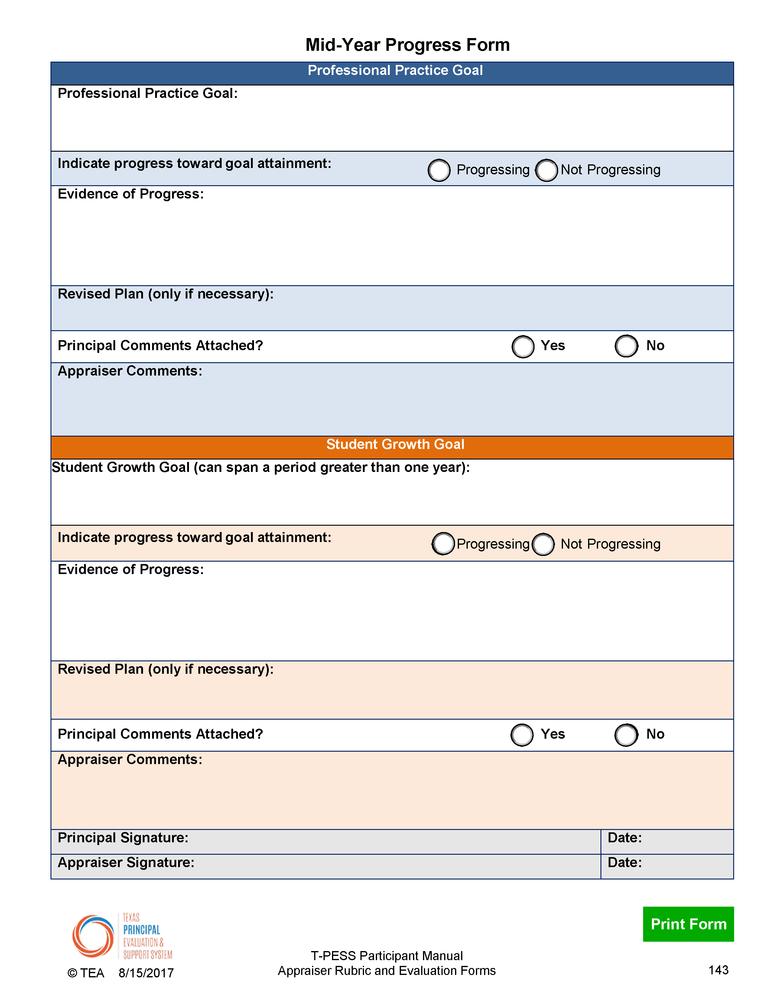
Mid-Year Progress Form
Notes:
The Mid-year Progress Form
1 min.
10:14 to 10:15
State: The Mid-year Progress Form serves to capture dialogue and decisions discussed during the MOY conference. The appraiser and the principal complete the form based on the available data, artifacts, and evidence as agreed upon in the Beginning-of-year Goal Setting Conference.

Slide 42

Step 6: Collect Evidence
& Artifacts (On-going)
Pg. 32
Take a few minutes to review the Participant Manual for information on the sixth step in T-PESS process: Collection of Evidence and Artifacts.
Make note of new information and questions.
Notes:
Review of Participant Manual to provide Background Knowledge for the Collection of Evidence and Artifacts.
1 min. for silent reading
10:15 to 10:16
State: Take a few minutes to read and make notes about the next step in the T-PESS process: Beginning of Year Conference.
Facilitator ensures a quiet environment for silent reading for 2 minutes. This activity is helpful to some of the adult learners in the room. The T-PESS graphic is helpful to others. We are trying to support everyone in gaining a strong conceptual understanding of the T-PESS process.

Slide 43
Artifacts and Evidence for EOY
The principal synthesizes data gathered throughout the year to provide a summary that best demonstrates the progress made related to the goals set.
A brief summary is provided to the appraiser in advance of the End-of-year Performance Discussion.
Notes:
Artifacts and Evidence for EOY
1 min.
10:16 to 10:17
State: In preparation for the End-of-year Performance Discussion and completion of the final Summary Evaluation Rating Form, it is important for the principal to prepare a collection of the data, artifacts, and evidence that supports his or her performance throughout the year and demonstrates progress toward attaining his or her professional goals. This assessment is NOT a portfolio of everything the principal has done throughout the school year. Rather, this is a summarization of the data, artifacts, and evidence pertaining to the principal's goals that were agreed on during the BOY Conference.

Slide 44
Step 7: End-of-Year
Conference & Goal Setting
Pg. 32
Take a few minutes to review the Participant Manual for information on the seventh step in T-PESS process: End-of-Year Conference.
Make note of new information and questions.
Notes:
Review of Participant Manual to provide Background Knowledge for End- of-Year Conference.
2 min. for silent reading
10:17 to 10:19
TOT:
State: Take a few minutes to read and make notes about the next step in the T-PESS process: End-of-Year Conference.
Facilitator ensures a quiet environment for silent reading for 2 minutes. This activity is helpful to some of the adult learners in the room. The T-PESS graphic is helpful to others. We are trying to support everyone in gaining a strong conceptual understanding of the T-PESS process.

Slide 45
End-of-Year Conference
An opportunity to discuss summative achievements from the year, including goal attainment, and to draft performance goals that reflect progress made and insights gained.
Afterwards, the appraiser will review all the data gathered, including information discussed during the EOY conference, when completing the Summative Annual Appraisal Report.
Notes:
The End of Year Conference is the culminating activity. It concludes the current year and looks forward to next.
1 min.
10:19 to 10:20
State: Now we are moving into the final stages of the annual T-PESS process. The End-of-year Performance Discussion is focused on taking stock of the leader’s performance over the course of the evaluation cycle. Additionally, final ratings will be shared with the principal following this conference. Like T-TESS, this is the opportunity for the principal to share what he or she is proud of accomplishing.. In determining final performance ratings, appraisers must take into account the overall performance of the leader benchmarked against his or her professional goals and all of the Texas Principal Standards.
State: T-PESS suggests that meetings between the appraiser and the principal are best conducted at the school site. Doing so presents several advantages including the opportunity to access any additional data, artifacts, or evidence that might be required to contribute an accurate assessment of the principal’s performance.

Slide 46
End-of-Year Conference
Goal Attainment
Planning Forward
T-PESS Rubric Performance
Opportunity for principal to provide input prior to summary rating.
Opportunity for supervisor to seek additional information related to T-PESS Rubric performance.
T-PESS is an ongoing process of self-reflection and growth. The EOY conference allows discussion of next phase of professional growth for the principal.
Summary Ratings
Final ratings determined after the appraiser reflects on input received at the EOY Conference.
Review the Professional Growth Plan to assess level of performance on GSPD.
Principal shares evidence and artifacts that supports goal progress and/or attainment
Consider future T-PESS goas for Professional Practice and Student Growth.
Notes:
EOY Graphic
1 min.
10:20 to 10:21
Review End of Year Conference Graphic.
Remind participants of the relationship with EOY conference in T-TESS.
This is where the principal gets to share evidence and bring things specifically to the attention of the appraiser to consider.
State: The End of Year Conference is the time and place where the principal has the opportunity to share evidence and artifacts related to his or her professional growth goal. Review of the GSPD plan takes place—just like the EOY conference in T-TESS. The appraiser leads the conference with reflective questions that explore goal attainment, overall principal performance, and planning forward for the following year. Summary ratings are determined by the appraiser AFTER this conference.
Invite people to turn and share with their table mates—what was the most valuable aspect of the EOY conference, in their opinion?

Slide 47
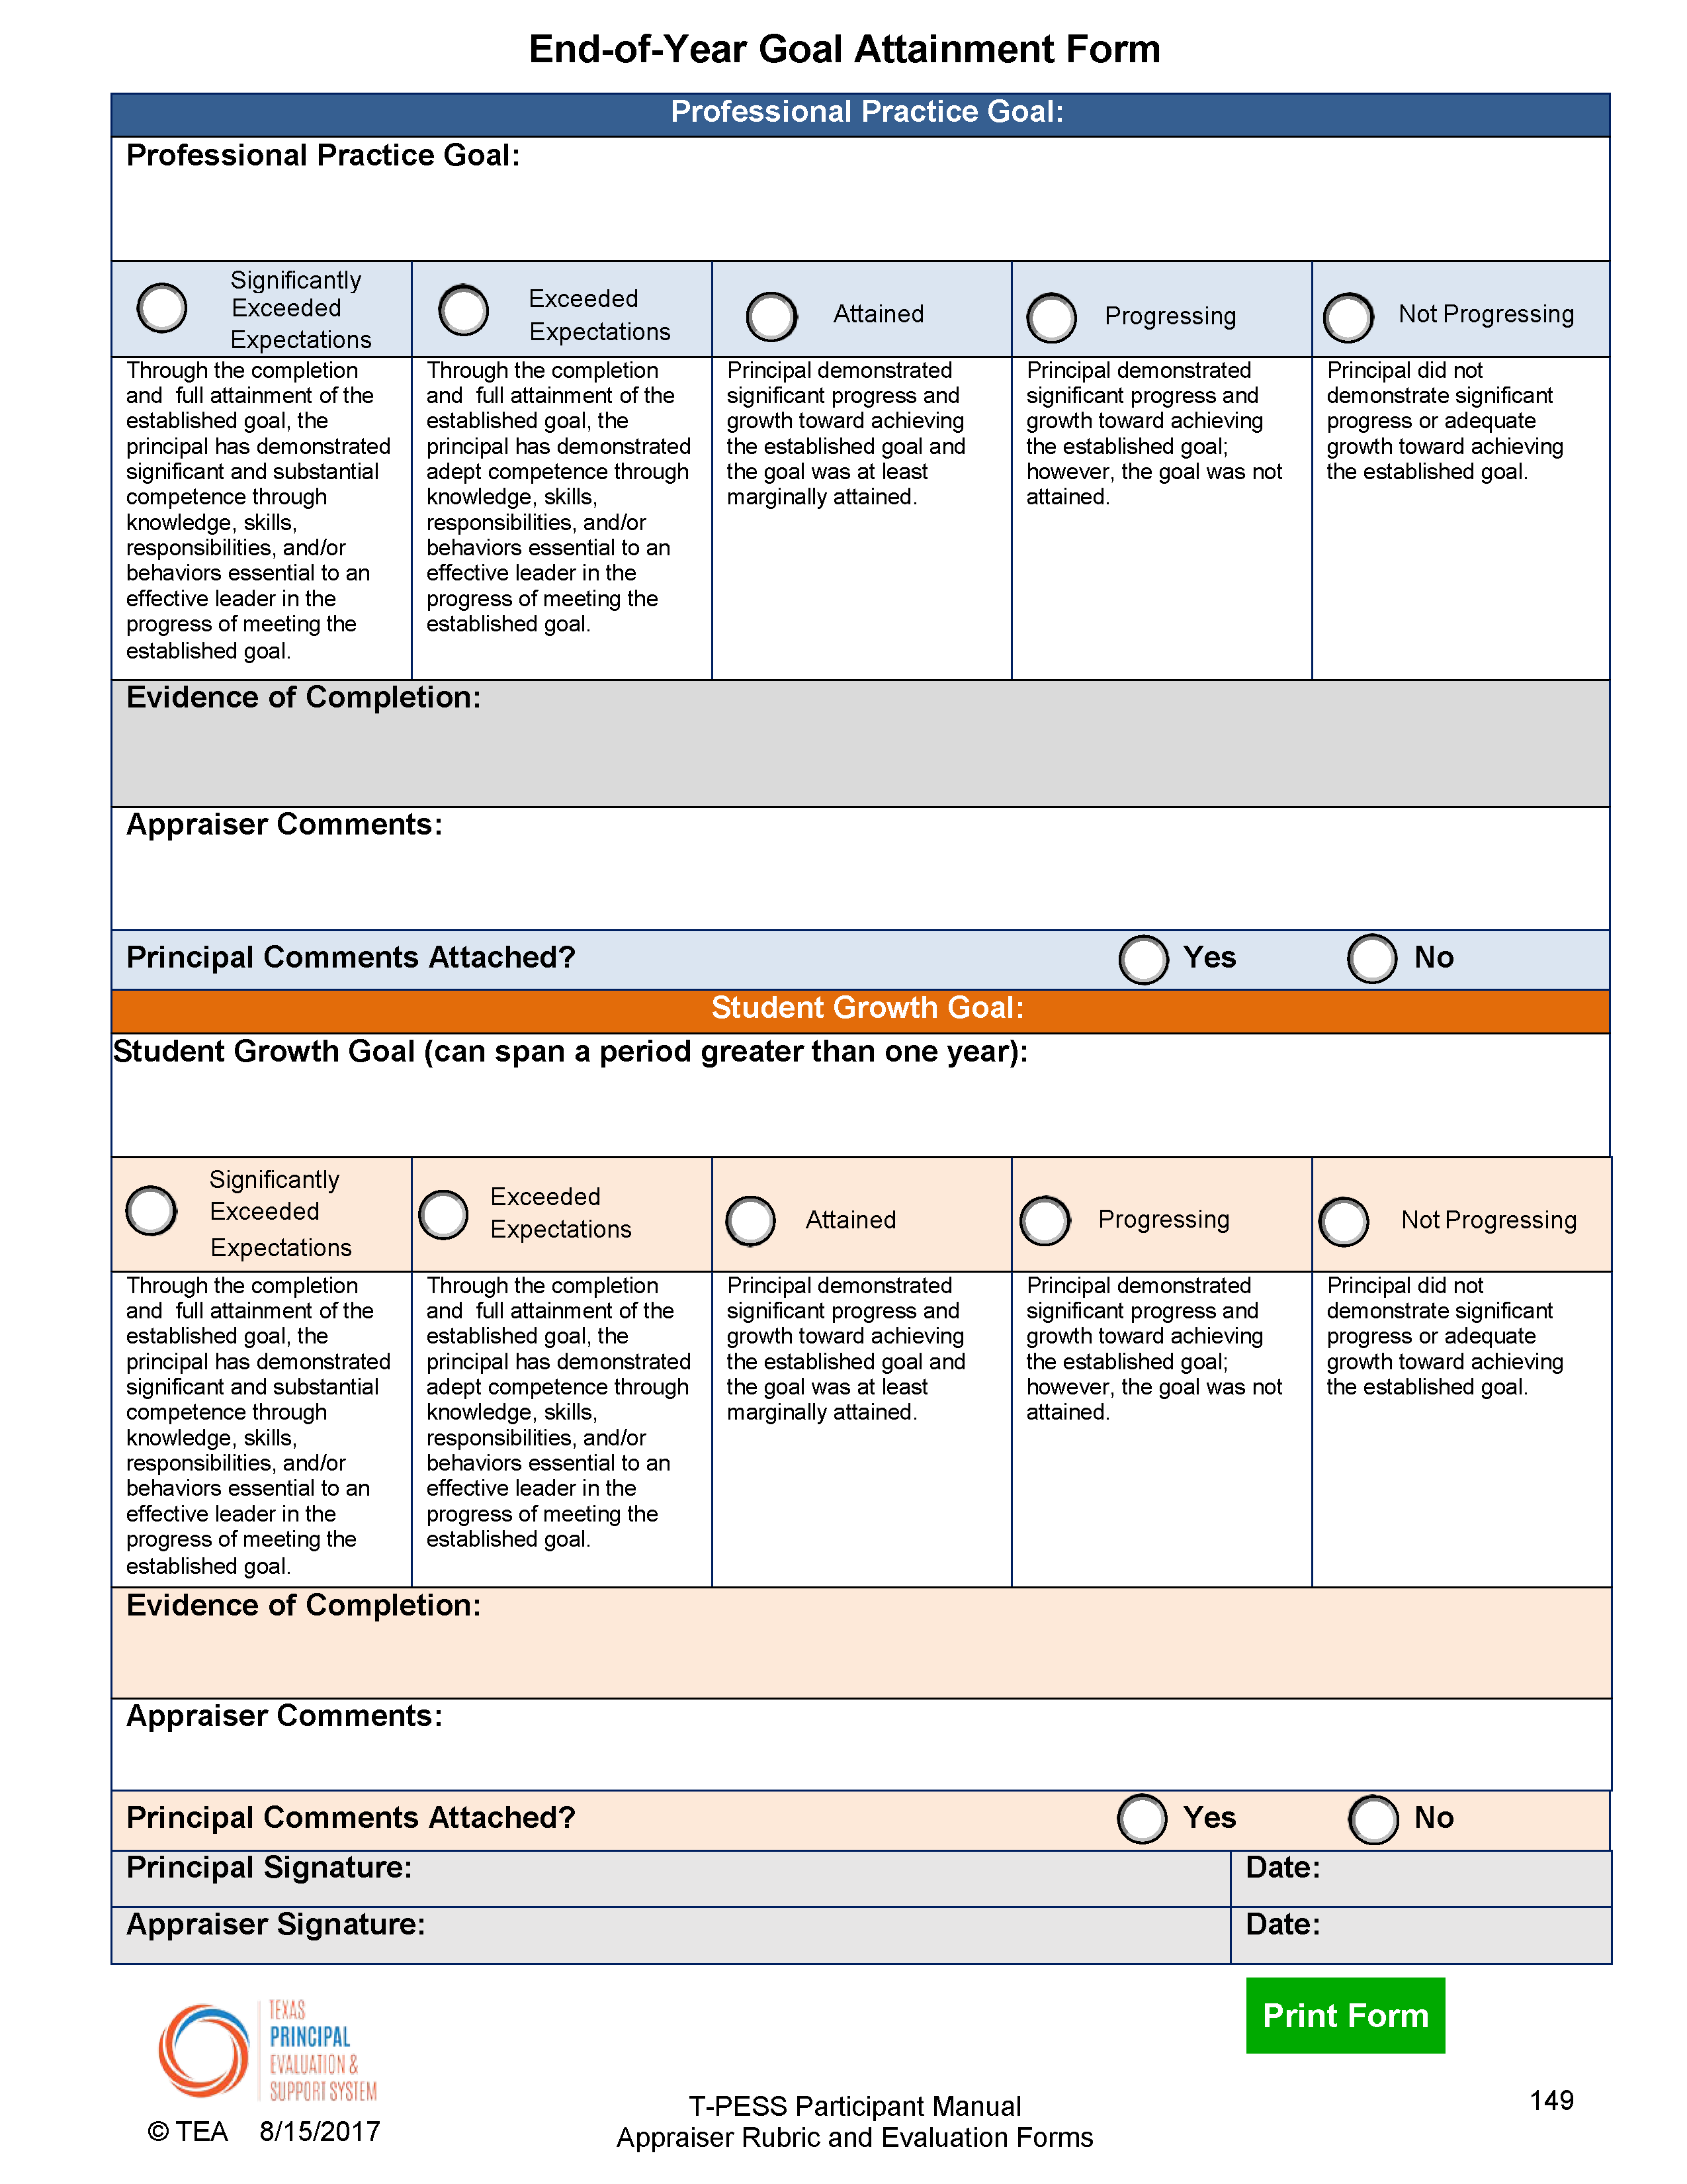
End-of-Year
Goal Attainment Form
Notes:
Original explanation of the EOY Goal Attainment Form.
1 min. 10:21 to 10:21
TOT:
State: “The Principal Evaluation Steering Committee concluded that goal setting, as a part of professional development, must play a significant role in the growth and development of the principal and must also be included as a factor in determining the overall performance of the principal. As a result, T-PESS includes a rubric that is used to determine the degree to which the principal attained his or her goal(s).
The End-of-year Goal Attainment Form will be used by appraisers in determining the degree to which the principal has accomplished his or her goal(s). It is reasonable to assume that in some cases a particular goal may be carried over into the next year.”
Note to Facilitator
The Texas Principal Evaluation Steering Committee determined that goal attainment is more than a zero sum where either you accomplished your goal and get credit or you didn’t and get no credit. Instead, the Steering Committee recognized that goal attainment may exceed an annual time frame.

Slide 48
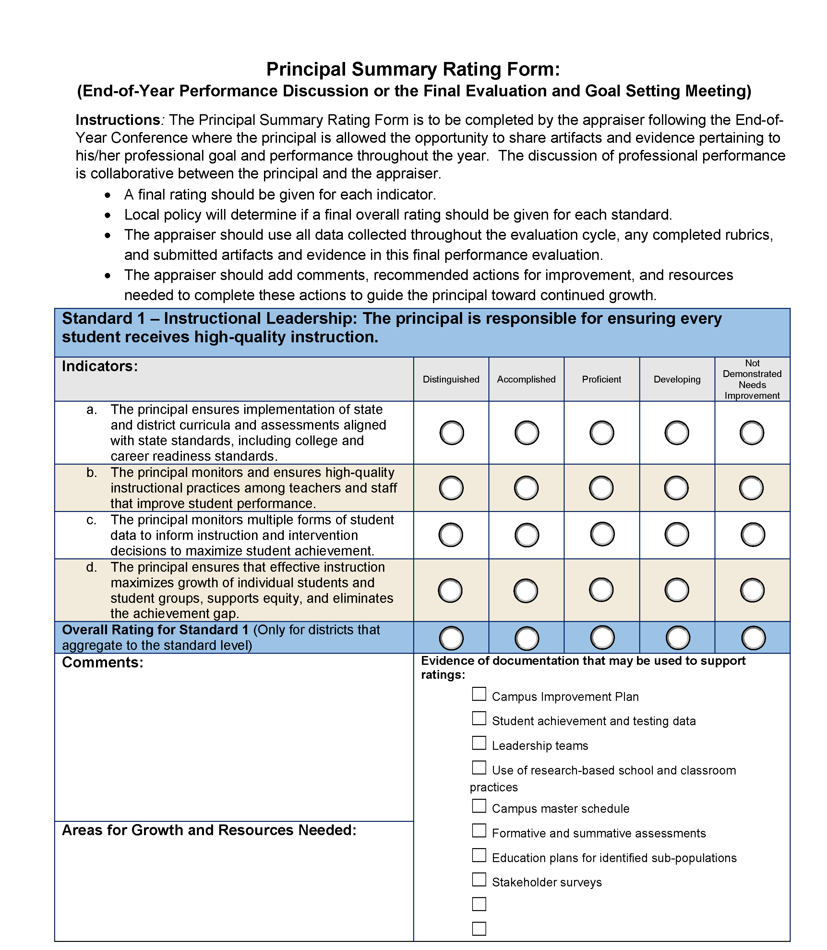
Summary Rating Form
Notes:
Original: Example of the Summary Rating Form. There is ONE per Standard for a total of 5 pages.
NOTE: THE OVERALL RATING SCORE IS NOT REQUIRED. Districts may score each Standard at the level of the Indicator.
1 min. 10:21 to 10:22
TOT:
State: The formative annual process of collecting performance data and providing constructive feedback rolls up to provide a Summary of the school-level leader’s performance. This “quick at a glance” form provide the appraiser with the data necessary to make final performance ratings.
In preparation for the End-of-year Performance Discussion, the appraiser should:
1. Review the performance goals,
2. Review the Mid-year Progress Form,
3. take stock of the information contained in the summary provided by the principal, and
4. reflect on the principal’s performance in relation to his or her goals, the Texas Principal Standards, and identified leadership practices.
This slide illustrates the Summary Rating Form. It is necessary to provide summary ratings for all indicators and an overall rating for each standard of T-PESS however districts are not required to provide an overall score for each Standard.
Indicator ratings should reflect the scoring rule (cumulative and additive). That score will transfer directly to the Summary Rating Form. If the district is using a single score for each standard, the overall score for each standard should take into account the indicator ratings and any artifacts, evidence, and data supporting performance related to a standard.
Note to Facilitator
You may want to review the rubric scoring rule. Doing so will help participants see the relationship between rubric scoring methodology and determining summary ratings.

Slide 49
New Electronic T-PESS Forms on TPESS.org
Notes:
A new tool to help principals and appraisers throughout the process: New Forms can be found on TPESS.org Take a few minutes to show the audience the website and new forms for principals and supervisors.
1 min.
10:22 to 10:23
State: To assist both the principal and the appraiser, the T-PESS forms have been updated to provide increased ease of use throughout the process. You still have the option to print these out but as you will see the functionality supports the idea of ongoing reflection and dialogue between principal and appraiser. (Walk through the forms on-line. Demonstrate that they are somewhat interactive and there is a form for Principals (for Self-Assessment) and a form for Appraisers with all rating forms included. ) The forms have been designed to provide a place to capture ideas and reflection on-going through-out the year.

Slide 50
Let’s Pause and Reflect
What questions are on your mind?
What clarification do you still need?
What new insights have you gained?
Notes:
3 min.10:23 to 10:26
So now that we have walked through the process as a whole…
ASK the group:
What questions are on your mind?
What clarification do you still need?
What new insights have you gained?

Slide 51
T-PESS Process
Notes:
Re-Anchor
1 min.
10:26 to 10:27
State: So now that we’ve experienced each step of the T-PESS process, let’s think more about implementation and what systems are in place to help support you through the process….
(Provide district specific information…)

Slide 52
T-PESS System & Process
Texas Principal Standards
Systematic Delivery Model
Professional Outcomes
Standard 1
Instructional Leadership
Standard 2
Human Capital
Standard 3
Executive Leadership
Standard 4
School Culture
Standard 5
Strategic Operations
Common vocabulary associated with professional practice
Identify pathway for professional improvement
Reduce instructional variability
Student Achievement
Increase instructional quality
Notes:
T-PESS System and Desired Outcomes
1 min.
10:27 to 10:28
State: “As a reminder of how the T-PESS process fits with the Texas Principal Standards and stakeholder goals for the evaluation process. You have had an opportunity to examine, evaluate, and make meaning of the leadership responsibilities and practices related to T-PESS.”
CLICK
The evaluation system is supported by a systematic annual cycle for evaluating and supporting school leader performance.
CLICK
When applied with fidelity and consistency this system will contribute to significant outcomes such as, establishing a common leadership vocabulary, identifying a pathway to professional improvement, and…
CLICK
With thoughtful implementation, T-PESS will serve to reduce instructional variability, increase instructional quality and most importantly, improve student achievement all as a result of strengthening leadership practice.
And we know that by helping principals build and strengthen capacity leads to increased teacher performance and student outcomes!

Slide 53
Moving Forward…Next Steps
Notes:
Closure—Talk about Next Steps with T-PESS in YOUR DISTRICT
10:28 to 10:30
Note to Trainers – some additional activities will be available to help facilitate ongoing discussion of T-PESS.

